Slide 2
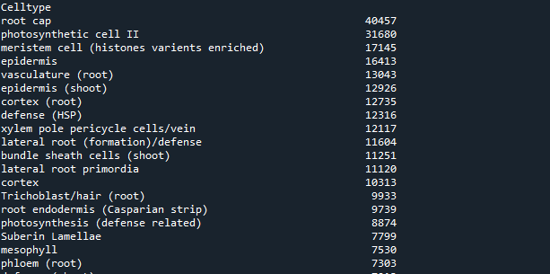
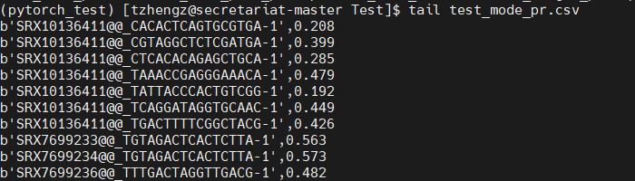
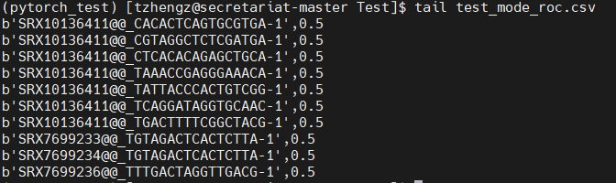

Slide 3
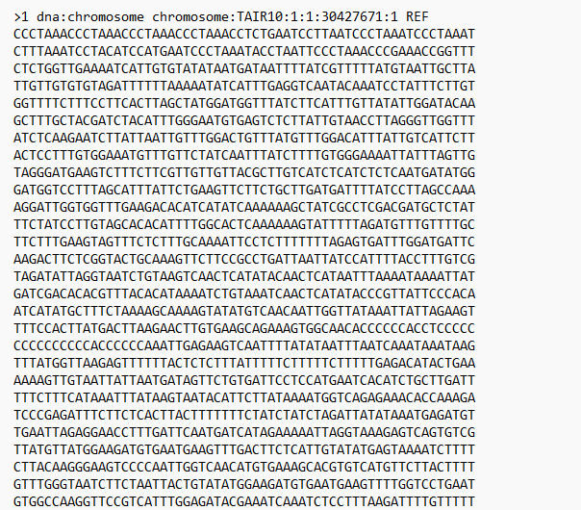
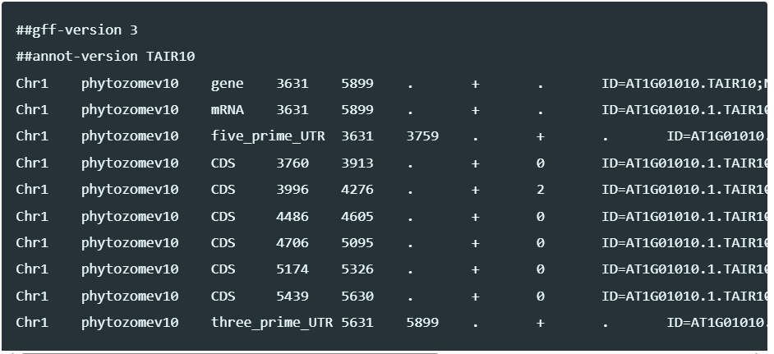
Data preparation: one hot
genome
annotation
0_proc_prom_region_seq.py
Species_updown500bp.onehot.p
Updown500.fa
Gtf files
0_proc_prom_region_seq.py
500
gene
+
500
gene
-
500
500
Species_updown500bp.onehot.p

Slide 4
Data preparation: Label 1_MAGIC_MCA.py
Single cell data
Normalize
Filter
Log
Smooth
Two decimal place
Pre-process
Convert to 1/0
H5ad new
label

Slide 5
2_propare_datasets.py

Slide 6
Training data description

Slide 7
Type | shape
celltype | (134557,)
test_data | (1466, 4, 20000)
test_gene | (1466,)
test_label | (1466, 134557)
train_data | (34464, 4, 20000)
train_gene | (34464,)
train_label | (34464, 134557)
val_data | (2000, 4, 20000)
val_gene | (2000,)
val_label | (2000, 134557)
annotation | (134557, 4)

Slide 8
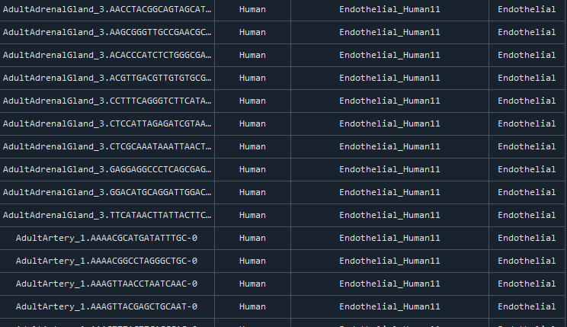
Annotation

Slide 9
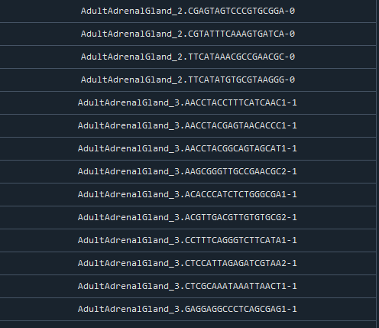
celltype

Slide 10
data
(number of seq,[A,T,C,G],length of each seq)

Slide 11
gene
(number of gene)

Slide 12
Genome
(train)
Single cell
(label)
CNN
(embeddings)
RNN
(LSTM)
MLP
(tower)

Slide 13
ATAC
Genome
(train)
Single cell
(label)
transformer
(embeddings)
Bert
(LSTM)
MLP
(tower)

